Slide 1
W4111 – Introduction to Databases Section 002, Spring 2022 Lecture 4: ER, Relational, SQL (III)
© Donald F. Ferguson, 2022

Slide 2

Contents
2 | Introduction to Databases (S22): Lecture 4: ER, Relational, SQL (III) © Donald F. Ferguson, 2022

Slide 3
Contents
Codd’s Rules and the systematic treatment of NULL.
Intermediate SQL concepts:
Data types and functions.
INSERT, UPDATE, DELETE.
ORDER BY.
Aggregate functions, GROUP BY.
More fun with JOIN.
Set like operations and functions.
A little more relational algebra and the dreaded “RelaX Calculator.”
Some hands on if we have time.

Slide 4
Codd’s Rules Systematic Treatment of NULL
4 | Introduction to Databases (S22): Lecture 4: ER, Relational, SQL (III) © Donald F. Ferguson, 2022

Slide 5
Codd’s 12 Rules
Rule 1: Information Rule
The data stored in a database, may it be user data or metadata, must be a value of some table cell. Everything in a database must be stored in a table format.
Rule 2: Guaranteed Access Rule
Every single data element (value) is guaranteed to be accessible logically with a combination of table-name, primary-key (row value), and attribute-name (column value). No other means, such as pointers, can be used to access data.
Rule 3: Systematic Treatment of NULL Values
The NULL values in a database must be given a systematic and uniform treatment. This is a very important rule because a NULL can be interpreted as one the following − data is missing, data is not known, or data is not applicable.
Rule 4: Active Online Catalog
The structure description of the entire database must be stored in an online catalog, known as data dictionary, which can be accessed by authorized users. Users can use the same query language to access the catalog which they use to access the database itself.
Rule 5: Comprehensive Data Sub-Language Rule
A database can only be accessed using a language having linear syntax that supports data definition, data manipulation, and transaction management operations. This language can be used directly or by means of some application. If the database allows access to data without any help of this language, then it is considered as a violation.
Rule 6: View Updating Rule
All the views of a database, which can theoretically be updated, must also be updatable by the system.

Slide 6
Codd’s 12 Rules
Rule 7: High-Level Insert, Update, and Delete Rule
A database must support high-level insertion, updation, and deletion. This must not be limited to a single row, that is, it must also support union, intersection and minus operations to yield sets of data records.
Rule 8: Physical Data Independence
The data stored in a database must be independent of the applications that access the database. Any change in the physical structure of a database must not have any impact on how the data is being accessed by external applications.
Rule 9: Logical Data Independence
The logical data in a database must be independent of its user’s view (application). Any change in logical data must not affect the applications using it. For example, if two tables are merged or one is split into two different tables, there should be no impact or change on the user application. This is one of the most difficult rule to apply.
Rule 10: Integrity Independence
A database must be independent of the application that uses it. All its integrity constraints can be independently modified without the need of any change in the application. This rule makes a database independent of the front-end application and its interface.
Rule 11: Distribution Independence
The end-user must not be able to see that the data is distributed over various locations. Users should always get the impression that the data is located at one site only. This rule has been regarded as the foundation of distributed database systems.
Rule 12: Non-Subversion Rule
If a system has an interface that provides access to low-level records, then the interface must not be able to subvert the system and bypass security and integrity constraints.

Slide 7
Codd’s 12 Rules
Rule 3: Systematic treatment of null values:
“Null values (distinct from the empty character string or a string of blank characters and distinct from zero or any other number) are supported in fully relational DBMS for representing missing information and inapplicable information in a systematic way, independent of data type.”
Sometimes programmers and database designers are tempted to use “special values” to indicate unknow, missing or inapplicable values.
String: “”, “NA”, “UNKNOWN”, ...
Numbers: -1, 0, -9999
Indicators can cause confusion because you have to carefully code some SQL statements to the specific, varying choices programmers made.

Slide 8
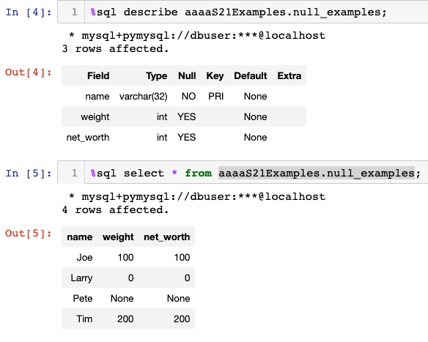
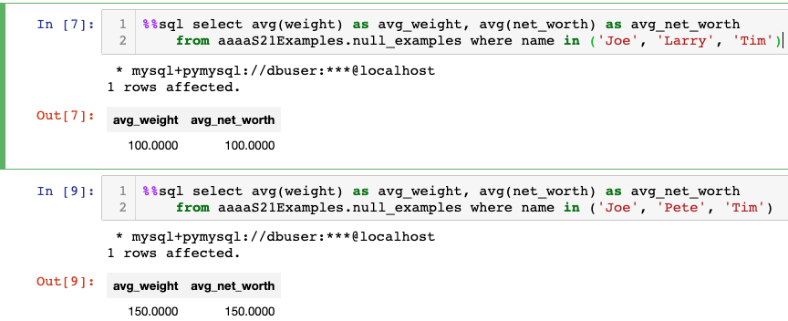
NULL and Correct Answers
Without NULL, to get a correct answer:
I must understand the domain to determine “unknown” values or know what choice a developer made.
Explicitly include “where weight != 0” in all statements.
And this varies from column to column, table to table, schema to schema, etc.

Slide 9
NULL and Correct Answers
Show in notebook.

Slide 10
Some More SQL
10 | COMS W4111_002_2022_1: Lecture 3: ER, Relational, SQL (II) © Donald F. Ferguson, 2022

Slide 11

Data Types and Functions
(Some Details)
11 | COMS W4111_002_2022_1: Lecture 3: ER, Relational, SQL (II) © Donald F. Ferguson, 2022

Slide 12
Some Data and Time Functions
Switch to notebook.

Slide 13
Order By

Slide 14
Ordering the Display of Tuples
List in alphabetic order the names of all instructors
select distinct name from instructor order by name
We may specify desc for descending order or asc for ascending order, for each attribute; ascending order is the default.
Example: order by name desc
Can sort on multiple attributes
Example: order by dept_name, name
Show notebook for order by example.

Slide 15
INSERT, UPDATE, DELETE
15 | COMS W4111_002_2022_1: Lecture 3: ER, Relational, SQL (III) © Donald F. Ferguson, 2022

Slide 16
Updates to tables
Insert
insert into instructor values ('10211', 'Smith', 'Biology', 66000);
Delete
Remove all tuples from the student relation
delete from student
Drop Table
drop table r
Alter
alter table r add A D
where A is the name of the attribute to be added to relation r and D is the domain of A.
All exiting tuples in the relation are assigned null as the value for the new attribute.
alter table r drop A
where A is the name of an attribute of relation r
Dropping of attributes not supported by many databases.

Slide 17
Modification of the Database
Deletion of tuples from a given relation.
Insertion of new tuples into a given relation
Updating of values in some tuples in a given relation

Slide 18
Deletion
Delete all instructors
delete from instructor
Delete all instructors from the Finance department delete from instructor where dept_name= 'Finance’;
Delete all tuples in the instructor relation for those instructors associated with a department located in the Watson building.
delete from instructor where dept name in (select dept name from department where building = 'Watson');

Slide 19
Deletion (Cont.)
Delete all instructors whose salary is less than the average salary of instructors
Problem: as we delete tuples from instructor, the average salary changes
Solution used in SQL:
First, compute avg (salary) and find all tuples to delete
Next, delete all tuples found above (without recomputing avg or retesting the tuples)
delete from instructor
where salary < (select avg (salary)
from instructor);

Slide 20
Insertion
Add a new tuple to course
insert into course values ('CS-437', 'Database Systems', 'Comp. Sci.', 4);
or equivalently
insert into course (course_id, title, dept_name, credits) values ('CS-437', 'Database Systems', 'Comp. Sci.', 4);
Add a new tuple to student with tot_creds set to null
insert into student values ('3003', 'Green', 'Finance', null);

Slide 21
Insertion (Cont.)
Make each student in the Music department who has earned more than 144 credit hours an instructor in the Music department with a salary of $18,000.
insert into instructor select ID, name, dept_name, 18000 from student where dept_name = 'Music' and total_cred > 144;
The select from where statement is evaluated fully before any of its results are inserted into the relation.
Otherwise queries like
insert into table1 select * from table1
would cause problem

Slide 22
Updates
Give a 5% salary raise to all instructors
update instructor set salary = salary * 1.05
Give a 5% salary raise to those instructors who earn less than 70000 update instructor set salary = salary * 1.05 where salary < 70000;
Give a 5% salary raise to instructors whose salary is less than average
update instructor set salary = salary * 1.05 where salary < (select avg (salary) from instructor);

Slide 23
Updates (Cont.)
Increase salaries of instructors whose salary is over $100,000 by 3%, and all others by a 5%
Write two update statements:
update instructor set salary = salary * 1.03 where salary > 100000; update instructor set salary = salary * 1.05 where salary <= 100000;
The order is important
Can be done better using the case statement (next slide)

Slide 24
Case Statement for Conditional Updates
Same query as before but with case statement
update instructor set salary = case when salary <= 100000 then salary * 1.05 else salary * 1.03 end

Slide 25
Updates with Scalar Subqueries
Recompute and update tot_creds value for all students
update student S set tot_cred = (select sum(credits) from takes, course where takes.course_id = course.course_id and S.ID= takes.ID.and takes.grade <> 'F' and takes.grade is not null);
Sets tot_creds to null for students who have not taken any course
Instead of sum(credits), use:
case when sum(credits) is not null then sum(credits) else 0 end

Slide 26
Summary
INSERT, UPDATE and DELETE are pretty straightforward.
UPDATE and DELETE are very similar to SELECT
WHERE clause specifies which rows are affected.
The SELECT choose the columns to return.
The SET clause chooses and changes columns.
DELETE just removes the specified rows.
INSERT, UPDATE and DELETE changes must not violate constraints, e.g.
INSERT a row that causes a duplicate key.
DELETE a referenced (target) foreign key.
UPDATE columns that create a duplicate key.
INSERT values do not include all NOT NULL columns.
I am not going to do example now, but you have seen and will see me do examples in the context of larger examples.

Slide 27
Aggregate Functions
27 | COMS W4111_002_2022_1: Lecture 3: ER, Relational, SQL (III) © Donald F. Ferguson, 2022

Slide 28
Aggregate Functions
These functions operate on the multiset of values of a column of a relation, and return a value
avg: average value min: minimum value max: maximum value sum: sum of values count: number of values
Note: Some database implementations have additional aggregate functions.

Slide 29
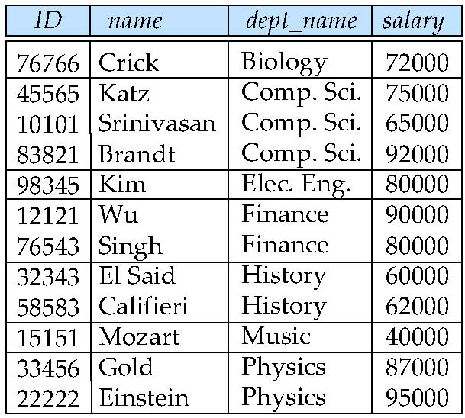
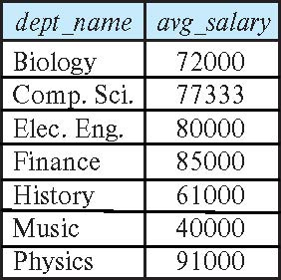
Aggregate Functions – Group By
Find the average salary of instructors in each department
select dept_name, avg (salary) as avg_salary from instructor group by dept_name;

Slide 30
Another View
GROUP BY column list
Forms partitions containing multiple rows.
All rows in a partition have the same values for the GROUP BY columns.
The aggregate functions
Merge the non-group by attributes, which may differ from row to row.
Into a single value for each attribute.
The result is one row per distinct set of GROUP BY values.
There may be multiple non-GROUP BY COLUMNS, each with its own aggregate function.
You can use HAVING in place of WHERE on the GROUP BY result.

Slide 31
Aggregate Functions Examples
Find the average salary of instructors in the Computer Science department
select avg (salary) from instructor where dept_name= 'Comp. Sci.';
Find the total number of instructors who teach a course in the Spring 2018 semester
select count (distinct ID) from teaches where semester = 'Spring' and year = 2018;
Find the number of tuples in the course relation
select count (*) from course;

Slide 32
Aggregation (Cont.)
Attributes in select clause outside of aggregate functions must appear in group by list
/* erroneous query */ select dept_name, ID, avg (salary) from instructor group by dept_name;

Slide 33
Aggregate Functions – Having Clause
Find the names and average salaries of all departments whose average salary is greater than 42000
Note: predicates in the having clause are applied after the formation of groups whereas predicates in the where clause are applied before forming groups
select dept_name, avg (salary) as avg_salary
from instructor
group by dept_name
having avg (salary) > 42000;

Slide 34
JOIN
34 | COMS W4111_002_2022_1: Lecture 3: ER, Relational, SQL (III) © Donald F. Ferguson, 2022

Slide 35
Joined Relations
Join operations take two relations and return as a result another relation.
A join operation is a Cartesian product which requires that tuples in the two relations match (under some condition). It also specifies the attributes that are present in the result of the join
The join operations are typically used as subquery expressions in the from clause
Three types of joins:
Natural join
Inner join
Outer join
Notes:
You will also hear terms like equi-join, non-equi-join, theta join, semi-join, ... ...
I ask for definitions on exams, but you can just look them up.

Slide 36
Natural Join in SQL
Natural join matches tuples with the same values for all common attributes, and retains only one copy of each common column.
List the names of instructors along with the course ID of the courses that they taught
select name, course_id from students, takes where student.ID = takes.ID;
Same query in SQL with “natural join” construct
select name, course_id from student natural join takes;

Slide 37
Natural Join in SQL (Cont.)
The from clause can have multiple relations combined using natural join:
select A₁, A₂, … A_{n} from r₁ natural join r₂ natural join .. natural join r_{n} where P ;

Slide 38
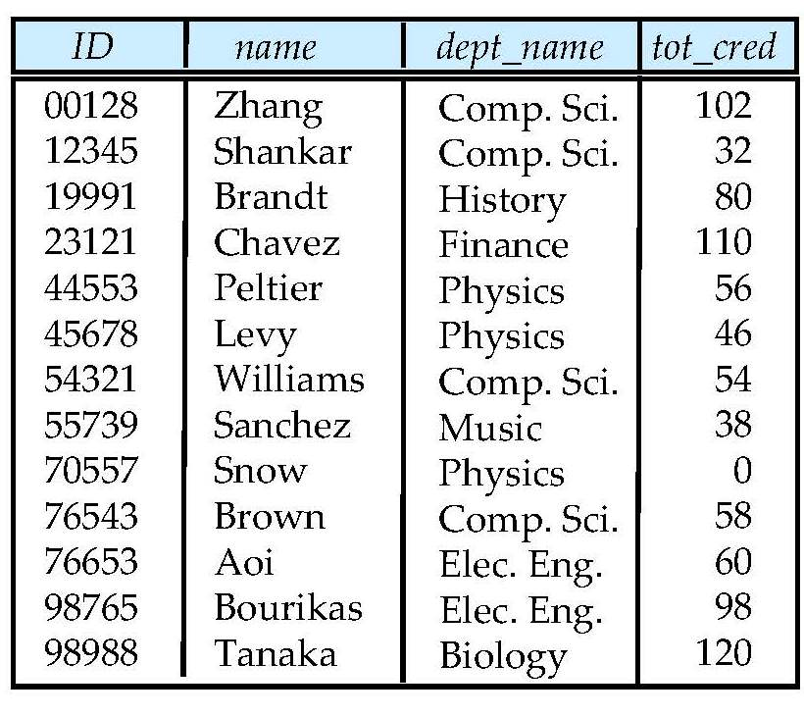
Student Relation

Slide 39
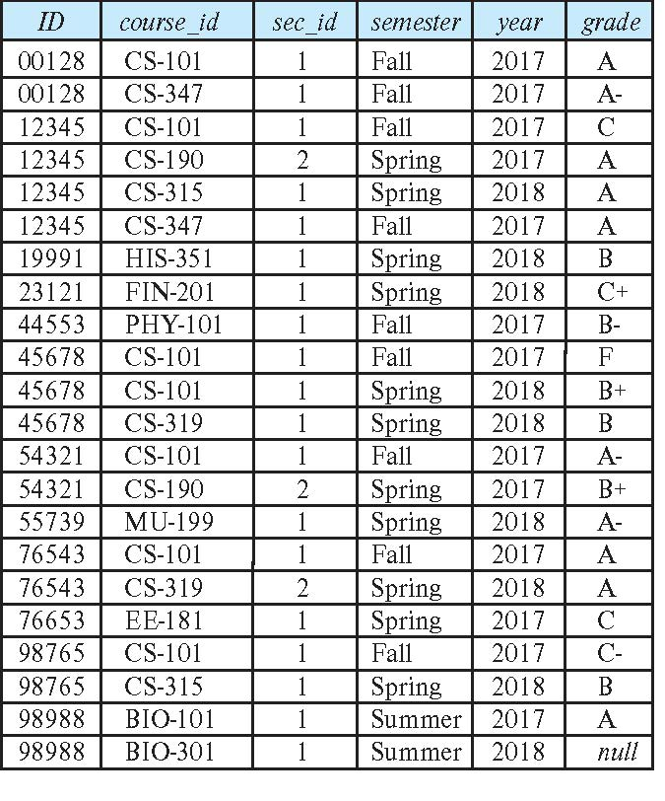
Takes Relation

Slide 40
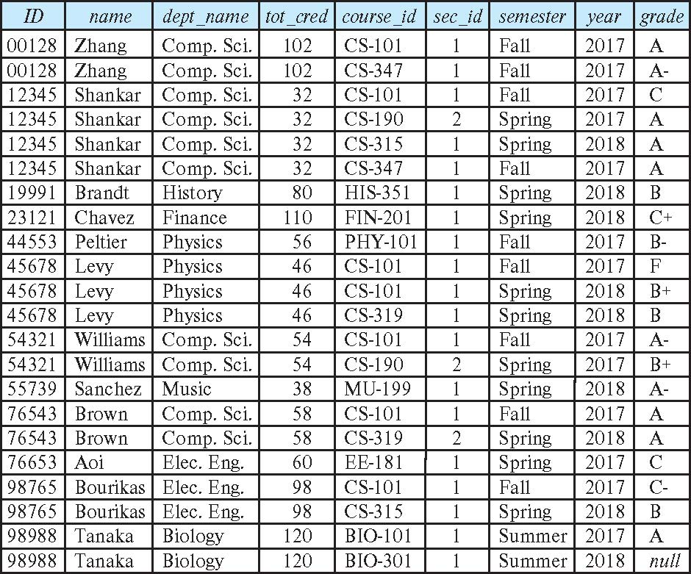
student natural join takes

Slide 41
Dangerous in Natural Join
Beware of unrelated attributes with same name which get equated incorrectly
Example -- List the names of students instructors along with the titles of courses that they have taken
Correct version
select name, title from student natural join takes, course where takes.course_id = course.course_id;
Incorrect version
select name, title from student natural join takes natural join course;
This query omits all (student name, course title) pairs where the student takes a course in a department other than the student's own department.
The correct version (above), correctly outputs such pairs.

Slide 42
Natural Join with Using Clause
To avoid the danger of equating attributes erroneously, we can use the “using” construct that allows us to specify exactly which columns should be equated.
Query example
select name, title from (student natural join takes) join course using (course_id)

Slide 43
Join Condition
The on condition allows a general predicate over the relations being joined
This predicate is written like a where clause predicate except for the use of the keyword on
Query example
select * from student join takes on student_ID = takes_ID
The on condition above specifies that a tuple from student matches a tuple from takes if their ID values are equal.
Equivalent to:
select * from student , takes where student_ID = takes_ID

Slide 44
Join Condition (Cont.)
The on condition allows a general predicate over the relations being joined.
This predicate is written like a where clause predicate except for the use of the keyword on.
Query example
select * from student join takes on student_ID = takes_ID
The on condition above specifies that a tuple from student matches a tuple from takes if their ID values are equal.
Equivalent to:
select * from student , takes where student_ID = takes_ID

Slide 45
One Way to Think About Joins

Slide 46
Set Operations
46 | COMS W4111_002_2022_1: Lecture 3: ER, Relational, SQL (III) © Donald F. Ferguson, 2022

Slide 47
Set Operations

Slide 48
Set Operations (Cont.)
Set operations union, intersect, and except
Each of the above operations automatically eliminates duplicates
To retain all duplicates use the
union all,
intersect all
except all.
NOTE:
SELECT implementing a project can have duplicate rows. If you do not want duplicates, you must use the DISTINCT key word.
UNION behaves the other way. It removes duplicates. If you want to keep the duplicates, you have to select UNION ALL.
Some SQL engines do not implement INTERSECT and/or EXCEPT, you can implement the function with subqueries, which we will cover soon.

Slide 49
Set Operations
Find courses that ran in Fall 2017 or in Spring 2018
(select course_id from section where sem = 'Fall' and year = 2017) union (select course_id from section where sem = 'Spring' and year = 2018)
Find courses that ran in Fall 2017 and in Spring 2018
(select course_id from section where sem = 'Fall' and year = 2017) intersect (select course_id from section where sem = 'Spring' and year = 2018)
Find courses that ran in Fall 2017 but not in Spring 2018
(select course_id from section where sem = 'Fall' and year = 2017) except (select course_id from section where sem = 'Spring' and year = 2018)

Slide 50
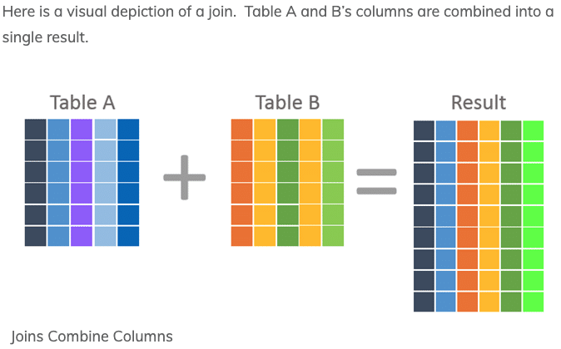
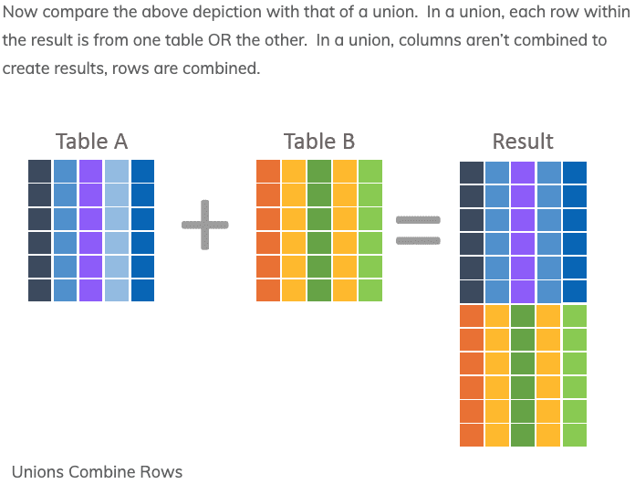
JOIN and UNION – A Final Word
UNION vs JOIN can be confusing. Basically,
JOIN puts the tables together “side by side.”
Union puts the tables together “one on top of the oter.”

Slide 51
Sub-Query
51 | COMS W4111_002_2022_1: Lecture 3: ER, Relational, SQL (III) © Donald F. Ferguson, 2022

Slide 52
Nested Subqueries
SQL provides a mechanism for the nesting of subqueries. A subquery is a select-from-where expression that is nested within another query.
The nesting can be done in the following SQL query select A₁, A₂, ..., A_{n} from r₁, r₂, ..., r_{m} where P
as follows:
From clause: r_{i} can be replaced by any valid subquery
Where clause: P can be replaced with an expression of the form:
B <operation> (subquery)
B is an attribute and <operation> to be defined later.
Select clause:
A_{i} can be replaced be a subquery that generates a single value.
Note:
This is a little cryptic.
I think I know what they mean.
There are some operations we will see later in the material, e.g IN, EXISTS, ... ...

Slide 53
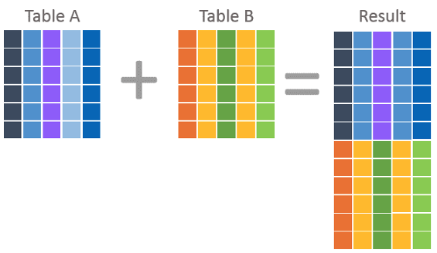
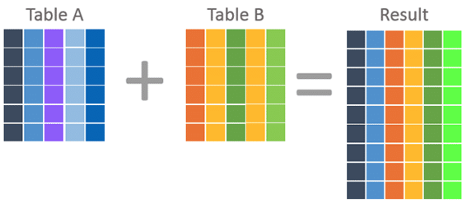
Nested Subquery
The slides that come with the book have surprisingly little material on nested subqueries.
The concept is:
Extremely important.
Students often find subqueries more confusing than joins.
The relationship/difference of subqueries to joins is often, initial unclear.
We have seen:
Union sort of puts a table on top of a table.
Join puts tables sort of puts tables side-by-side.
Subquery enables one query to call another during execution like a subfunction.

Slide 54
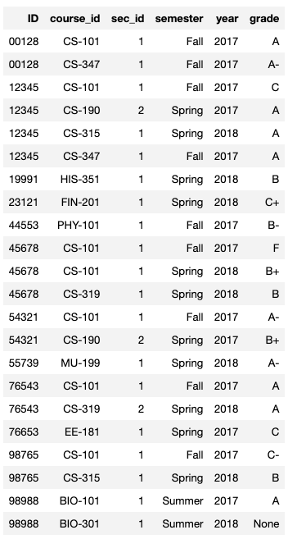
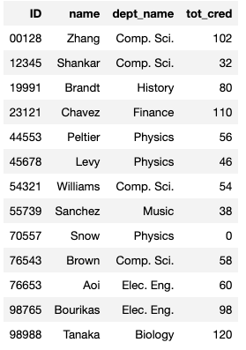
Consider Some Tables
Student
Takes

Slide 55
Consider a Subquery Tables
select *, (select name from student where student.id=takes.id) as name from takes;
Assume I wrote a function find_student_name(x)
Input is an x
Loops through all students and returns students with student.ID = x.
The query with a subquery above is like:
result = []
For t in takes:
new_r = t + find_student_name(t.id)
result.append(new_r)
Switch to Notebook
Takes
Student

Slide 56
Nested Subqueries
SQL provides a mechanism for the nesting of subqueries. A subquery is a select-from-where expression that is nested within another query.
The nesting can be done in the following SQL query select A₁, A₂, ..., A_{n} from r₁, r₂, ..., r_{m} where P
as follows:
From clause: r_{i} can be replaced by any valid subquery
Where clause: P can be replaced with an expression of the form:
B <operation> (subquery)
B is an attribute and <operation> to be defined later.
Select clause:
A_{i} can be replaced be a subquery that generates a single value.
Note: Subquery MUST return
A single scalar if in the SELECT.
A Table if in the FROM.
If in the WHERE:
Either a scalar or a table.
Depending on the operation.

Slide 57
Set Membership

Slide 58
Set Membership
Find courses offered in Fall 2017 and in Spring 2018
Find courses offered in Fall 2017 but not in Spring 2018
select distinct course_id
from section
where semester = 'Fall' and year= 2017 and course_id in (select course_id
from section
where semester = 'Spring' and year= 2018);
select distinct course_id
from section
where semester = 'Fall' and year= 2017 and course_id not in (select course_id
from section
where semester = 'Spring' and year= 2018);

Slide 59
Set Membership (Cont.)
Name all instructors whose name is neither “Mozart” nor Einstein”
select distinct name
from instructor
where name not in ('Mozart', 'Einstein')
Find the total number of (distinct) students who have taken course sections taught by the instructor with ID 10101
Note: Above query can be written in a much simpler manner. The formulation above is simply to illustrate SQL features
select count (distinct ID)
from takes
where (course_id, sec_id, semester, year) in (select course_id, sec_id, semester, year
from teaches
where teaches.ID= 10101);

Slide 60
Set Comparison

Slide 61
Set Comparison – “some” Clause
Find names of instructors with salary greater than that of some (at least one) instructor in the Biology department.
Same query using > some clause
select distinct T.name
from instructor as T, instructor as S
where T.salary > S.salary and S.dept name = 'Biology';
select name
from instructor
where salary > some (select salary
from instructor
where dept name = 'Biology');

Slide 62
Definition of “some” Clause
F <comp> some r ⇔ ∃ t ∈ r such that (F <comp> t ) Where <comp> can be: <, ≤, >, =, ≠
0
(5 < some
5
) = true
(read: 5 < some tuple in the relation)
6
0
(5 < some
5
) = false
0
(5 = some
) = true
5
0
(5 ≠ some
5
) = true (since 0 ≠ 5)
(= some) ≡ in
However, (≠ some) ≡ not in

Slide 63
Set Comparison – “all” Clause
Find the names of all instructors whose salary is greater than the salary of all instructors in the Biology department.
select name
from instructor
where salary > all (select salary
from instructor
where dept name = 'Biology');

Slide 64
Definition of “all” Clause
F <comp> all r ⇔ ∀ t ∈ r (F <comp> t)
0
(5 < all
5
) = false
6
6
(5 < all
) = true
10
4
(5 = all
) = false
5
4
(5 ≠ all
) = true (since 5 ≠ 4 and 5 ≠ 6)
6
(≠ all) ≡ not in
However, (= all) ≡ in

Slide 65
Test for Empty Relations
The exists construct returns the value true if the argument subquery is nonempty.
exists r ⇔ r ≠ Ø
not exists r ⇔ r = Ø

Slide 66
Use of “exists” Clause
Yet another way of specifying the query “Find all courses taught in both the Fall 2017 semester and in the Spring 2018 semester”
select course_id from section as S where semester = 'Fall' and year = 2017 and exists (select * from section as T where semester = 'Spring' and year= 2018 and S.course_id = T.course_id);
Correlation name – variable S in the outer query
Correlated subquery – the inner query

Slide 67
Use of “not exists” Clause
Find all students who have taken all courses offered in the Biology department.
Note that X – Y = Ø ⇔ X ⊆ Y
Note: Cannot write this query using = all and its variants
select distinct S.ID, S.name
from student as S
where not exists ( (select course_id
from course
where dept_name = 'Biology')
except
(select T.course_id
from takes as T
where S.ID = T.ID));
First nested query lists all courses offered in Biology
Second nested query lists all courses a particular student took

Slide 68
Test for Absence of Duplicate Tuples
The unique construct tests whether a subquery has any duplicate tuples in its result.
The unique construct evaluates to “true” if a given subquery contains no duplicates .
Find all courses that were offered at most once in 2017
select T.course_id from course as T where unique ( select R.course_id from section as R where T.course_id= R.course_id and R.year = 2017);

Slide 69
Subqueries in the From Clause

Slide 70
Subqueries in the Form Clause
SQL allows a subquery expression to be used in the from clause
Find the average instructors’ salaries of those departments where the average salary is greater than $42,000.”
select dept_name, avg_salary from ( select dept_name, avg (salary) as avg_salary from instructor group by dept_name) where avg_salary > 42000;
Note that we do not need to use the having clause
Another way to write above query
select dept_name, avg_salary from ( select dept_name, avg (salary) from instructor group by dept_name)
as dept_avg (dept_name, avg_salary)
where avg_salary > 42000;

Slide 71
With Clause
The with clause provides a way of defining a temporary relation whose definition is available only to the query in which the with clause occurs.
Find all departments with the maximum budget with max_budget (value) as (select max(budget) from department) select department.name from department, max_budget where department.budget = max_budget.value;

Slide 72
Complex Queries using With Clause
Find all departments where the total salary is greater than the average of the total salary at all departments
with dept _total (dept_name, value) as
(select dept_name, sum(salary)
from instructor
group by dept_name),
dept_total_avg(value) as
(select avg(value)
from dept_total)
select dept_name
from dept_total, dept_total_avg
where dept_total.value > dept_total_avg.value;

Slide 73
Scalar Subquery
Scalar subquery is one which is used where a single value is expected
List all departments along with the number of instructors in each department
select dept_name, ( select count(*) from instructor where department.dept_name = instructor.dept_name) as num_instructors from department;
Runtime error if subquery returns more than one result tuple

Slide 74
Insert, Update, Delete
74 | Introduction to Databases (S22): Lecture 4: ER, Relational, SQL (III) © Donald F. Ferguson, 2022

Slide 75
Modification of the Database
Deletion of tuples from a given relation.
Insertion of new tuples into a given relation
Updating of values in some tuples in a given relation

Slide 76
Copying Data Examples
/* Copy data but not keys, etc. */
create table department_backup as
select * from department;
/* Make an empty table lust like ... Including keys, etc. */
create table department_backup_cool like department;
/* Insert the result of the select into the table. */
insert into department_backup_cool select * from department;
/* Safe way to change data with aggregates in the where ... */
set @avg = (select avg(salary) from instructor);
select * from instructor where salary > @avg;

Slide 77
Deletion
Delete all instructors
delete from instructor
Delete all instructors from the Finance department delete from instructor where dept_name= 'Finance’;
Delete all tuples in the instructor relation for those instructors associated with a department located in the Watson building.
delete from instructor where dept name in (select dept name from department where building = 'Watson');

Slide 78
Deletion (Cont.)
Delete all instructors whose salary is less than the average salary of instructors
Problem: as we delete tuples from instructor, the average salary changes
Solution used in SQL:
First, compute avg (salary) and find all tuples to delete
Next, delete all tuples found above (without recomputing avg or retesting the tuples)
delete from instructor
where salary < (select avg (salary)
from instructor);

Slide 79
Insertion
Add a new tuple to course
insert into course values ('CS-437', 'Database Systems', 'Comp. Sci.', 4);
or equivalently
insert into course (course_id, title, dept_name, credits) values ('CS-437', 'Database Systems', 'Comp. Sci.', 4);
Add a new tuple to student with tot_creds set to null
insert into student values ('3003', 'Green', 'Finance', null);

Slide 80
Equivalent
insert into student values ('3003', 'Green', 'Finance', null);
insert into student(dept_name, ID, name)
values('Finance', '3003', 'Green');

Slide 81
Insertion (Cont.)
Make each student in the Music department who has earned more than 144 credit hours an instructor in the Music department with a salary of $18,000.
insert into instructor select ID, name, dept_name, 18000 from student where dept_name = 'Music' and total_cred > 144;
The select from where statement is evaluated fully before any of its results are inserted into the relation.
Otherwise queries like
insert into table1 select * from table1
would cause problem

Slide 82
Updates
Give a 5% salary raise to all instructors
update instructor set salary = salary * 1.05
Give a 5% salary raise to those instructors who earn less than 70000 update instructor set salary = salary * 1.05 where salary < 70000;
Give a 5% salary raise to instructors whose salary is less than average
update instructor set salary = salary * 1.05 where salary < (select avg (salary) from instructor);

Slide 83
Updates (Cont.)
Increase salaries of instructors whose salary is over $100,000 by 3%, and all others by a 5%
Write two update statements:
update instructor set salary = salary * 1.03 where salary > 100000; update instructor set salary = salary * 1.05 where salary <= 100000;
The order is important
Can be done better using the case statement (next slide)
Fixed
Exec
Fixed 2

Slide 84
Case Statement for Conditional Updates
Same query as before but with case statement
update instructor set salary = case when salary <= 100000 then salary * 1.05 else salary * 1.03 end

Slide 85
Updates with Scalar Subqueries
Recompute and update tot_creds value for all students
update student S set tot_cred = (select sum(credits) from takes, course where takes.course_id = course.course_id and S.ID= takes.ID.and takes.grade <> 'F' and takes.grade is not null);
Sets tot_creds to null for students who have not taken any course
Instead of sum(credits), use:
case when sum(credits) is not null then sum(credits) else 0 end

Slide 86
Summary
INSERT, UPDATE and DELETE are pretty straightforward.
UPDATE and DELETE are very similar to SELECT
WHERE clause specifies which rows are affected.
The SELECT choose the columns to return.
The SET clause chooses and changes columns.
DELETE just removes the specified rows.
INSERT, UPDATE and DELETE changes must not violate constraints, e.g.
INSERT a row that causes a duplicate key.
DELETE a referenced (target) foreign key.
UPDATE columns that create a duplicate key.
INSERT values do not include all NOT NULL columns.
I am not going to do example now, but you have seen and will see me do examples in the context of larger examples.

Slide 87
JOINs
87 | Introduction to Databases (S22): Lecture 4: ER, Relational, SQL (III) © Donald F. Ferguson, 2022

Slide 88
Joined Relations
Join operations take two relations and return as a result another relation.
A join operation is a Cartesian product which requires that tuples in the two relations match (under some condition). It also specifies the attributes that are present in the result of the join
The join operations are typically used as subquery expressions in the from clause
Three types of joins:
Natural join
Inner join
Outer join
Notes:
You will also hear terms like equi-join, non-equi-join, theta join, semi-join, ... ...
I ask for definitions on exams, but you can just look them up.

Slide 89
Natural Join in SQL
Natural join matches tuples with the same values for all common attributes, and retains only one copy of each common column.
List the names of instructors along with the course ID of the courses that they taught
select name, course_id from students, takes where student.ID = takes.ID;
Same query in SQL with “natural join” construct
select name, course_id from student natural join takes;

Slide 90
Natural Join in SQL (Cont.)
The from clause can have multiple relations combined using natural join:
select A₁, A₂, … A_{n} from r₁ natural join r₂ natural join .. natural join r_{n} where P ;

Slide 91
Student Relation

Slide 92
Takes Relation

Slide 93
student natural join takes

Slide 94
Dangerous in Natural Join
Beware of unrelated attributes with same name which get equated incorrectly
Example -- List the names of students’ instructors along with the titles of courses that they have taken
Correct version
select name, title from student natural join takes, course where takes.course_id = course.course_id;
Incorrect version
select name, title from student natural join takes natural join course;
This query omits all (student name, course title) pairs where the student takes a course in a department other than the student's own department.
The correct version (above), correctly outputs such pairs.

Slide 95
Natural Join with Using Clause
To avoid the danger of equating attributes erroneously, we can use the “using” construct that allows us to specify exactly which columns should be equated.
Query example
select name, title from (student natural join takes) join course using (course_id)

Slide 96
Join Condition
The on condition allows a general predicate over the relations being joined
This predicate is written like a where clause predicate except for the use of the keyword on
Query example
select * from student join takes on student_ID = takes_ID
The on condition above specifies that a tuple from student matches a tuple from takes if their ID values are equal.
Equivalent to:
select * from student , takes where student_ID = takes_ID

Slide 97
Join Condition (Cont.)
The on condition allows a general predicate over the relations being joined.
This predicate is written like a where clause predicate except for the use of the keyword on.
Query example
select * from student join takes on student_ID = takes_ID
The on condition above specifies that a tuple from student matches a tuple from takes if their ID values are equal.
Equivalent to:
select * from student , takes where student_ID = takes_ID

Slide 98
One Way to Think About Joins

Slide 99
Let’s Do Some Example
Theta Join: Find people in Lahman’s DB who appeared (played) after Managing.
Show in Jupyter Notebook
Players who played for the Boston Red Sox in 1967, and their Hall of Fame information if it exists.
Show in Jupyter Notebook
Emulating full outer join:
The basic id is union left join and a right join
(select * from x left join y) union (select * from x right join y)

Slide 100
Set Operations
100 | COMS W4111_002_2022_1: Lecture 3: ER, Relational, SQL (III) © Donald F. Ferguson, 2022

Slide 101
Set Operations

Slide 102
Set Operations (Cont.)
Set operations union, intersect, and except
Each of the above operations automatically eliminates duplicates
To retain all duplicates use the
union all,
intersect all
except all.
NOTE:
SELECT implementing a project can have duplicate rows. If you do not want duplicates, you must use the DISTINCT key word.
UNION behaves the other way. It removes duplicates. If you want to keep the duplicates, you have to select UNION ALL.
Some SQL engines do not implement INTERSECT and/or EXCEPT, you can implement the function with subqueries, which we will cover soon.

Slide 103
Set Operations
Find courses that ran in Fall 2017 or in Spring 2018
(select course_id from section where sem = 'Fall' and year = 2017) union (select course_id from section where sem = 'Spring' and year = 2018)
Find courses that ran in Fall 2017 and in Spring 2018
(select course_id from section where sem = 'Fall' and year = 2017) intersect (select course_id from section where sem = 'Spring' and year = 2018)
Find courses that ran in Fall 2017 but not in Spring 2018
(select course_id from section where sem = 'Fall' and year = 2017) except (select course_id from section where sem = 'Spring' and year = 2018)

Slide 104
JOIN and UNION – A Final Word
UNION vs JOIN can be confusing. Basically,
JOIN puts the tables together “side by side.”
Union puts the tables together “one on top of the oter.”

Slide 105
Sub-Query
105 | COMS W4111_002_2022_1: Lecture 3: ER, Relational, SQL (III) © Donald F. Ferguson, 2022

Slide 106
Nested Subqueries
SQL provides a mechanism for the nesting of subqueries. A subquery is a select-from-where expression that is nested within another query.
The nesting can be done in the following SQL query select A₁, A₂, ..., A_{n} from r₁, r₂, ..., r_{m} where P
as follows:
From clause: r_{i} can be replaced by any valid subquery
Where clause: P can be replaced with an expression of the form:
B <operation> (subquery)
B is an attribute and <operation> to be defined later.
Select clause:
A_{i} can be replaced be a subquery that generates a single value.
Note:
This is a little cryptic.
I think I know what they mean.
There are some operations we will see later in the material, e.g IN, EXISTS, ... ...

Slide 107
Nested Subquery
The slides that come with the book have surprisingly little material on nested subqueries.
The concept is:
Extremely important.
Students often find subqueries more confusing than joins.
The relationship/difference of subqueries to joins is often, initial unclear.
We have seen:
Union sort of puts a table on top of a table.
Join puts tables sort of puts tables side-by-side.
Subquery enables one query to call another during execution like a subfunction.

Slide 108
Consider Some Tables
Student
Takes

Slide 109
Consider a Subquery Tables
select *, (select name from student where student.id=takes.id) as name from takes;
Assume I wrote a function find_student_name(x)
Input is an x
Loops through all students and returns students with student.ID = x.
The query with a subquery above is like:
result = []
For t in takes:
new_r = t + find_student_name(t.id)
result.append(new_r)
Switch to Notebook
Takes
Student

Slide 110
Nested Subqueries
SQL provides a mechanism for the nesting of subqueries. A subquery is a select-from-where expression that is nested within another query.
The nesting can be done in the following SQL query select A₁, A₂, ..., A_{n} from r₁, r₂, ..., r_{m} where P
as follows:
From clause: r_{i} can be replaced by any valid subquery
Where clause: P can be replaced with an expression of the form:
B <operation> (subquery)
B is an attribute and <operation> to be defined later.
Select clause:
A_{i} can be replaced be a subquery that generates a single value.
Note: Subquery MUST return
A single scalar if in the SELECT.
A Table if in the FROM.
If in the WHERE:
Either a scalar or a table.
Depending on the operation.

Slide 111
Subqueries in the From Clause
SQL allows a subquery expression to be used in the from clause
Find the average instructors’ salaries of those departments where the average salary is greater than $42,000.”
select dept_name, avg_salary from ( select dept_name, avg (salary) as avg_salary from instructor group by dept_name) where avg_salary > 42000;
Note that we do not need to use the having clause
Another way to write above query
select dept_name, avg_salary from ( select dept_name, avg (salary) from instructor group by dept_name)
as dept_avg (dept_name, avg_salary)
where avg_salary > 42000;

Slide 112
With Clause
The with clause provides a way of defining a temporary relation whose definition is available only to the query in which the with clause occurs.
Find all departments with the maximum budget with max_budget (value) as (select max(budget) from department) select department.name from department, max_budget where department.budget = max_budget.value;

Slide 113
Complex Queries using With Clause
Find all departments where the total salary is greater than the average of the total salary at all departments
with dept _total (dept_name, value) as
(select dept_name, sum(salary)
from instructor
group by dept_name),
dept_total_avg(value) as
(select avg(value)
from dept_total)
select dept_name
from dept_total, dept_total_avg
where dept_total.value > dept_total_avg.value;

Slide 114
Scalar Subquery
Scalar subquery is one which is used where a single value is expected
List all departments along with the number of instructors in each department
select dept_name, ( select count(*) from instructor where department.dept_name = instructor.dept_name) as num_instructors from department;
Runtime error if subquery returns more than one result tuple

Slide 115
Set Membership
115 | COMS W4111_002_2022_1: Lecture 3: ER, Relational, SQL (III) © Donald F. Ferguson, 2022

Slide 116
Set Membership
Find courses offered in Fall 2017 and in Spring 2018
Find courses offered in Fall 2017 but not in Spring 2018
select distinct course_id
from section
where semester = 'Fall' and year= 2017 and course_id in (select course_id
from section
where semester = 'Spring' and year= 2018);
select distinct course_id
from section
where semester = 'Fall' and year= 2017 and course_id not in (select course_id
from section
where semester = 'Spring' and year= 2018);

Slide 117
Set Membership (Cont.)
Name all instructors whose name is neither “Mozart” nor Einstein”
select distinct name
from instructor
where name not in ('Mozart', 'Einstein')
Find the total number of (distinct) students who have taken course sections taught by the instructor with ID 10101
Note: Above query can be written in a much simpler manner. The formulation above is simply to illustrate SQL features
select count (distinct ID)
from takes
where (course_id, sec_id, semester, year) in (select course_id, sec_id, semester, year
from teaches
where teaches.ID= 10101);

Slide 118
Set Comparison – “some” Clause
Find names of instructors with salary greater than that of some (at least one) instructor in the Biology department.
Same query using > some clause
select distinct T.name
from instructor as T, instructor as S
where T.salary > S.salary and S.dept name = 'Biology';
select name
from instructor
where salary > some (select salary
from instructor
where dept name = 'Biology');

Slide 119
Definition of “some” Clause
F <comp> some r ⇔ ∃ t ∈ r such that (F <comp> t ) Where <comp> can be: <, ≤, >, =, ≠
0
(5 < some
5
) = true
(read: 5 < some tuple in the relation)
6
0
(5 < some
5
) = false
0
(5 = some
) = true
5
0
(5 ≠ some
5
) = true (since 0 ≠ 5)
(= some) ≡ in
However, (≠ some) ≡ not in

Slide 120
Set Comparison – “all” Clause
Find the names of all instructors whose salary is greater than the salary of all instructors in the Biology department.
select name
from instructor
where salary > all (select salary
from instructor
where dept name = 'Biology');

Slide 121
Definition of “all” Clause
F <comp> all r ⇔ ∀ t ∈ r (F <comp> t)
0
(5 < all
5
) = false
6
6
(5 < all
) = true
10
4
(5 = all
) = false
5
4
(5 ≠ all
) = true (since 5 ≠ 4 and 5 ≠ 6)
6
(≠ all) ≡ not in
However, (= all) ≡ in

Slide 122
Test for Empty Relations
The exists construct returns the value true if the argument subquery is nonempty.
exists r ⇔ r ≠ Ø
not exists r ⇔ r = Ø

Slide 123
Use of “exists” Clause
Yet another way of specifying the query “Find all courses taught in both the Fall 2017 semester and in the Spring 2018 semester”
select course_id from section as S where semester = 'Fall' and year = 2017 and exists (select * from section as T where semester = 'Spring' and year= 2018 and S.course_id = T.course_id);
Correlation name – variable S in the outer query
Correlated subquery – the inner query

Slide 124
Use of “not exists” Clause
Find all students who have taken all courses offered in the Biology department.
Note that X – Y = Ø ⇔ X ⊆ Y
Note: Cannot write this query using = all and its variants
select distinct S.ID, S.name
from student as S
where not exists ( (select course_id
from course
where dept_name = 'Biology')
except
(select T.course_id
from takes as T
where S.ID = T.ID));
First nested query lists all courses offered in Biology
Second nested query lists all courses a particular student took

Slide 125
Test for Absence of Duplicate Tuples
The unique construct tests whether a subquery has any duplicate tuples in its result.
The unique construct evaluates to “true” if a given subquery contains no duplicates .
Find all courses that were offered at most once in 2017
select T.course_id from course as T where unique ( select R.course_id from section as R where T.course_id= R.course_id and R.year = 2017);

Slide 126
Some More Relational Algebra
126 | Introduction to Databases (S22): Lecture 4: ER, Relational, SQL (III) © Donald F. Ferguson, 2022

Slide 127
Some Additional Operations
Left and right join
⟕
⟖
⟗
Semi-join
⋉
⋊
Anti-join: ▷
Order By: τ
Group By: γ
Division: ÷
Many of these are obscure, and many SQL implementations do not support.
You can “derive” them from other operations in many cases.
They are so obscure that the textbook does not cover some of them.

Slide 128
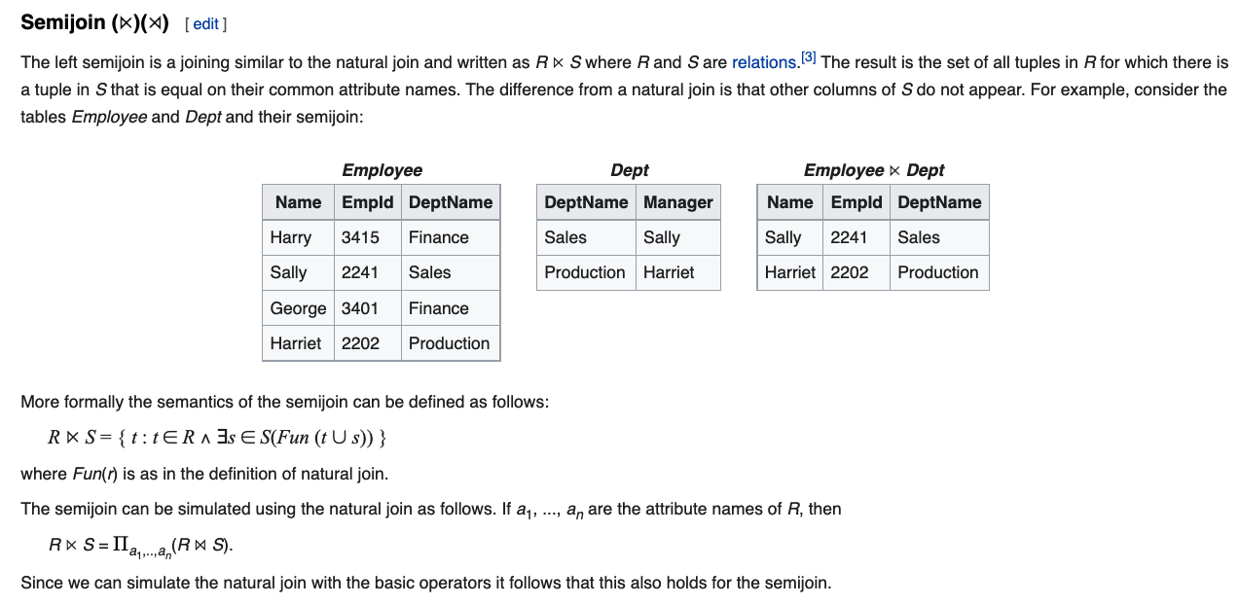
Semi-Join

Slide 129
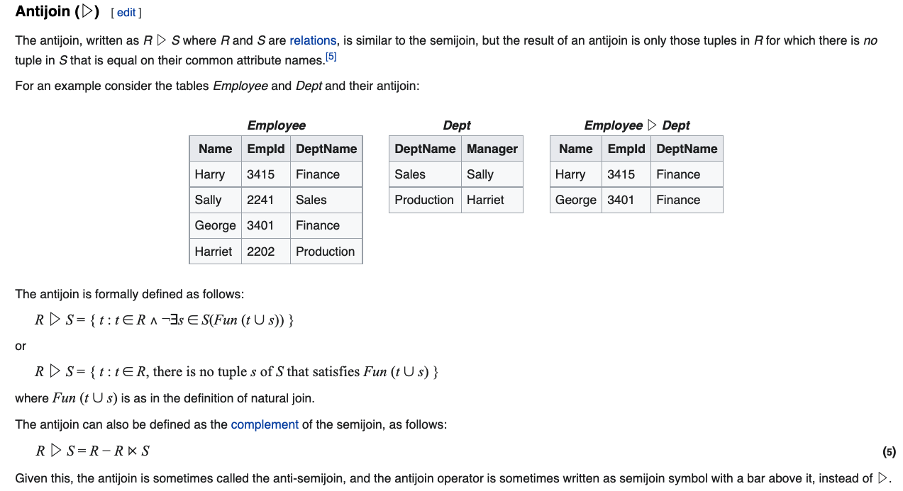
Anti-Join

Slide 130
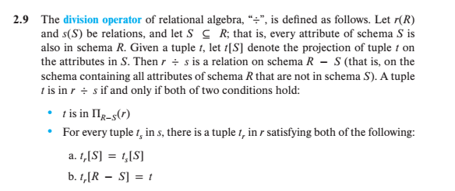
Division
Well, that is crystal clear.
My head hurts every time I must remember this for that one slide every semester. But, this makes a cool exam question!

Slide 131
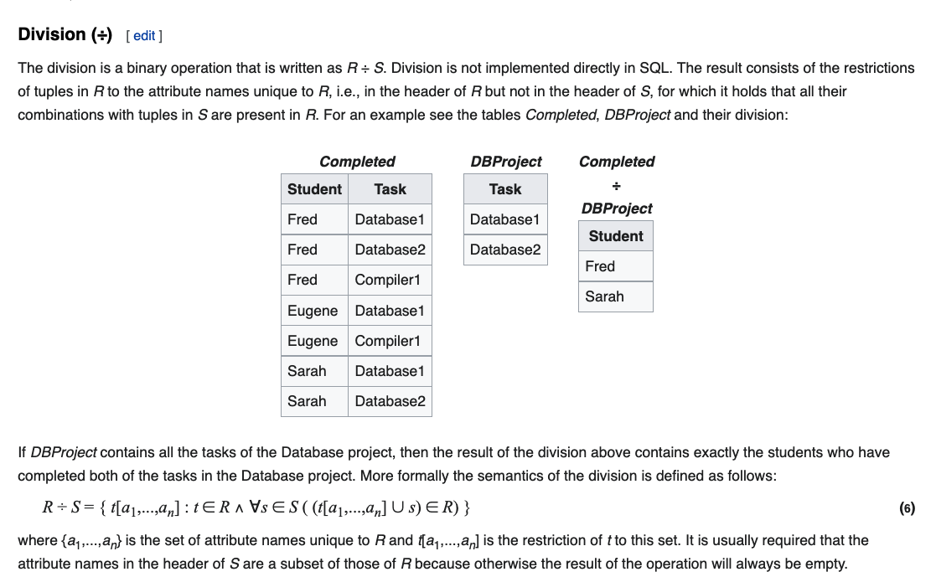
Division

Slide 132
Worked Example:
ER Model from scratch.
Schema definition, DDL, ... and some new concepts.
Where’s the data?
132 | Introduction to Databases (S22): Lecture 4: ER, Relational, SQL (III) © Donald F. Ferguson, 2022

Slide 133

Worked Example – Top Down
Scenario
Course with complex course ID.
Section
Faculty
Department
Instructor – Department Assoc. entity with properties (role, date).
Instructor – Section
Student - Section
Do ER (live) diagram in Lucidchart.
Do schema creation
In DataGrip
Show copying statements int the notebook.
No laughing when I make
mistakes!

Slide 134
CREATE TABLE `cu_model`.`courses` (
`dept_code` VARCHAR(4) NOT NULL,
`faculty_code` ENUM('BC', 'C', 'W', 'E', 'G') NOT NULL,
`credit_level` ENUM('0', '1', '2', '3', '4', '6', '8', '9') NOT NULL,
`course_no` VARCHAR(3) NOT NULL,
`title` VARCHAR(64) NOT NULL,
`full_course_no` VARCHAR(12) GENERATED ALWAYS AS (concat(dept_code,faculty_code,credit_level,course_no)),
PRIMARY KEY (`dept_code`, `faculty_code`, `credit_level`, `course_no`));

Slide 135
Bottom-Up: Some Sources of Information
Course Codes: https://www.cc-seas.columbia.edu/sites/dsa/files/handbooks/Columbia%20Key%20to%20Course%20Listing.pdf
Course/Section Properties: http://www.columbia.edu/cu/bulletin/uwb/
Common Search Criteria → Indexes, Query Parameters, Data Links https://doc.search.columbia.edu/classes/Ferguson?instr=&name=&days=&semes=&hour=&moi=
Department Information:
Script: https://www.columbia.edu/content/academics/departments
Codes: https://academic-admin.cuit.columbia.edu/dept_code
Specific Information:
Course and Instructor: https://opendataservice.columbia.edu/api/9/json
Vergil Data: https://vergil.registrar.columbia.edu/feeds/cw.js
Vergil Search: https://vergil.registrar.columbia.edu/doc-adv-queries.php?key=ferguson&moreresults=2

Slide 136
Meet in the Middle
Show cu_info project with data and processing.
Show notebook for loading the data.
Show getting part of the way through parsing HTML in project

